Slide 1



FOURTH YEAR
BS COMPUTER SCIENCE
ENROLLMENT MANAGEMENT SYSTEM WITH TREND ANALYSIS BY DEPARTMENT USING EXTREME GRADIENT BOOSTING ALGORITHM
THESIS II 2025

Slide 2

CHALLENGES
Manual Processes
Enrollment tasks like registration, verification, and payment tracking are currently done using paper forms and spreadsheets.
Time-Consuming Tasks
Staff spend a lot of time managing records and handling repetitive tasks.
Growing Complexity
As enrollment increases, it becomes harder to manage student data efficiently.
Limited Access to Insights
There’s no system in place to analyze enrollment trends for better planning.
Room for Improved Accuracy
Manual handling increases the chance of small errors, like payment mismatches.

Slide 3

OUR SYSTEM
"With the new EMS and trend analysis, WITI can make enrollment faster, more accurate, and easier to manage—while also helping the school see and plan for future student needs."

Slide 4



superadmin
registrar - admin
accounting - admin
professor
users
students

Slide 5

USER ACCOUNT CREATION MODULE

Slide 6

REGISTRATION MODULE

Slide 7

LOGIN MODULE

Slide 8

SETTINGS MODULE

Slide 9

ENROLLMENT SETUP MODULE

Slide 10
ENROLLMENT MODULE

Slide 11
PAYMENT SETUP MODULE

Slide 12
PAYMENT-RECEIPT TRACKING MODULE

Slide 13
GRADES-VIEWING MODULE

Slide 14
TREND ANALYSIS BY DEPARTMENT MODULE

Slide 15
WHY EMS?
Enrollment refers to a student's official registration at an academic institution. While enrollment processing can be complex, it is crucial for both students and institutions. A proposed Web-based Enrollment System with Reservation aims to improve accuracy in record – keeping and accommodate a higher number of enrollees simultaneously compared to manual registration. The study found that most students and parents possess devices with reliable internet access, making online enrollment an efficient and viable option. [8]
F. E. Bognot, M. F. J. Wy, M. O. Santos, J. R. Merciales, A. M. A. Padilla, and J. C. Jocson, "Process Optimization: An Impact to the Enrollment System of Aurora State College of Technology," International Journal of Progressive Research in Science and Engineering, vol. 2, no. 12, pp. 38-41, Dec. 2021. ISSN: 2582-7898.

Slide 16
WHY XGBOOST?
The use of XGBoost, along with other advanced machine learning models, has been explored for predicting student enrollment. Compared to traditional models, XGBoost demonstrated better classification accuracy, making it a suitable choice for enrollment forecasting. [34]
H. Bousnguar, L. Najdi, and A. Battou, “Developing An Interactive Web-Based Time Series Forecasting System With Deep Learning And LSTM For Student Enrollment Using Dash,” Journal for Re Attach Therapy and Developmental Diversities, vol. 6, no. 10s2, pp. 1649–1656, Dec. 2023.

Slide 17
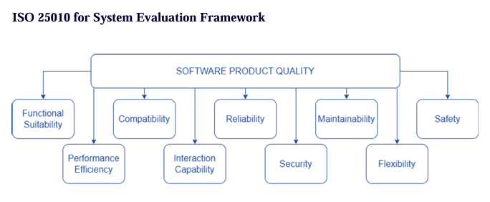
users

Slide 18
users

Slide 19
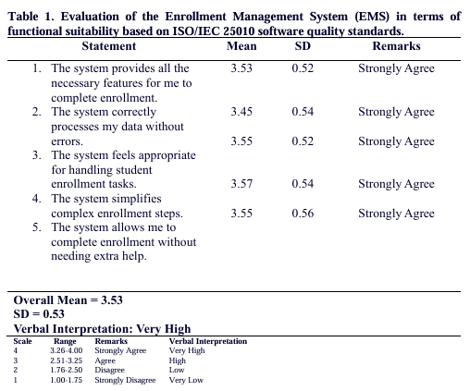
users

Slide 20
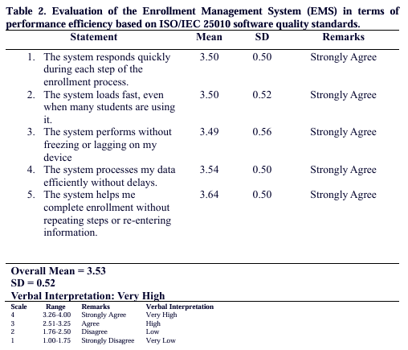
users

Slide 21
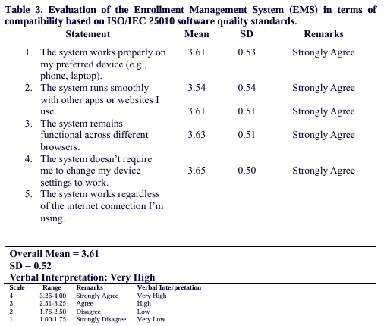
users

Slide 22
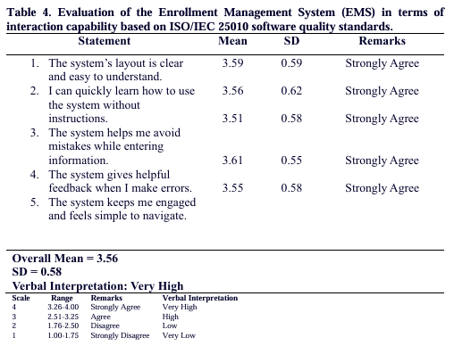
users

Slide 23
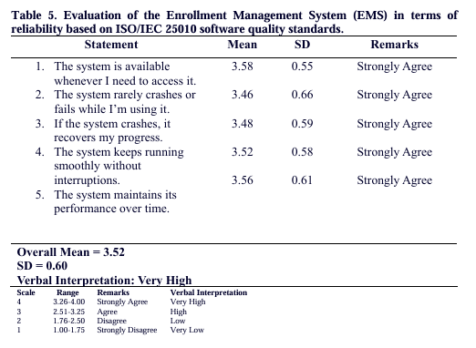
users

Slide 24
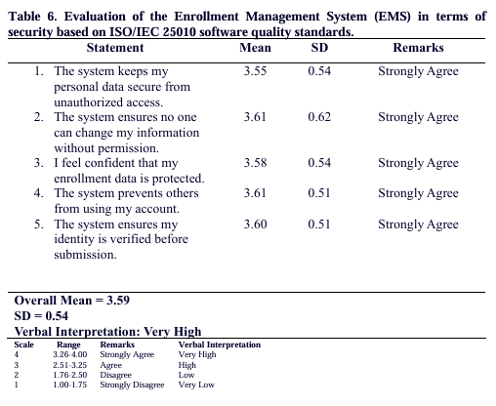
users

Slide 25
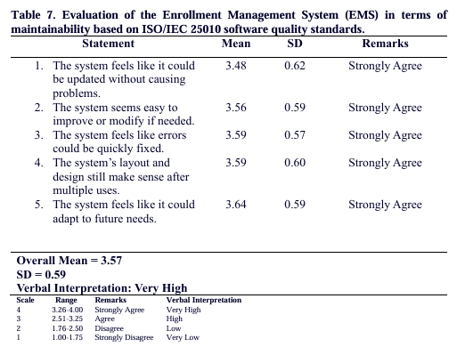
users

Slide 26
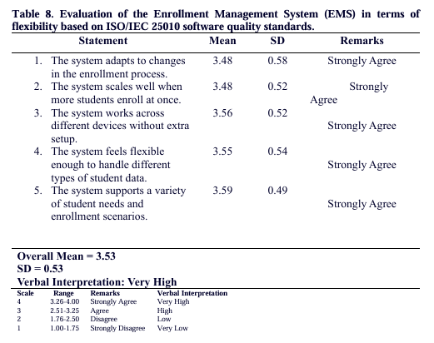
users

Slide 27
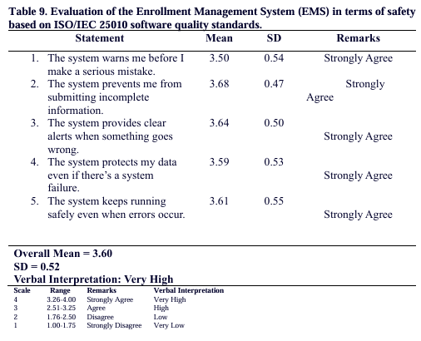
users

Slide 28
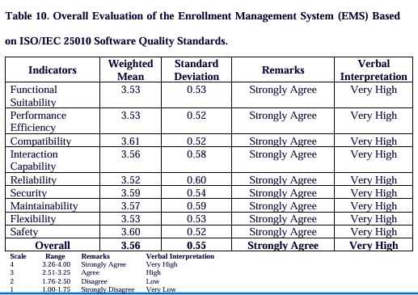
users

Slide 29
Overall, the EMS achieved an average weighted mean of 3.56 (SD=0.55), interpreted as Very High. The low to moderate SD values across all indicators underscore a general agreement among users, confirming that the system meets ISO/IEC 25010 standards at a high level of effectiveness. This positions the EMS as a reliable, secure, and well-performing tool for enrollment management, with strong adaptability and consistent performance across key quality attributes.
users

